Slide 1


Slide 2

My former employer, ‘The Latvian Proxy Network’

Slide 3
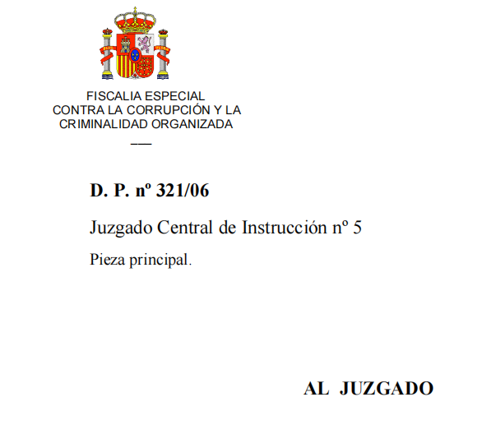
Tambovskaya Mafia trial 2015

Slide 4
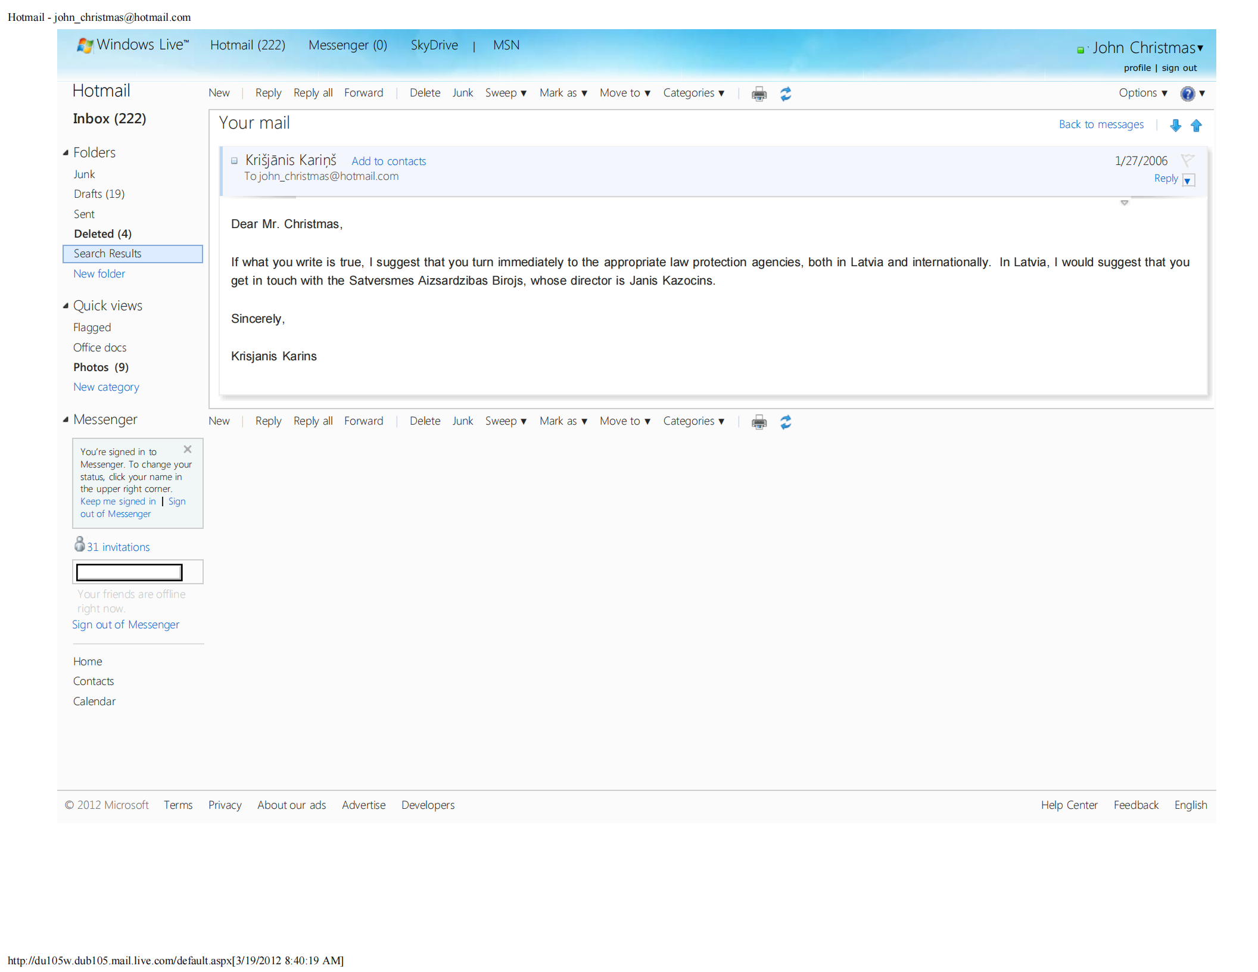
Prime Minister Krisjanis Karins knows

Slide 5
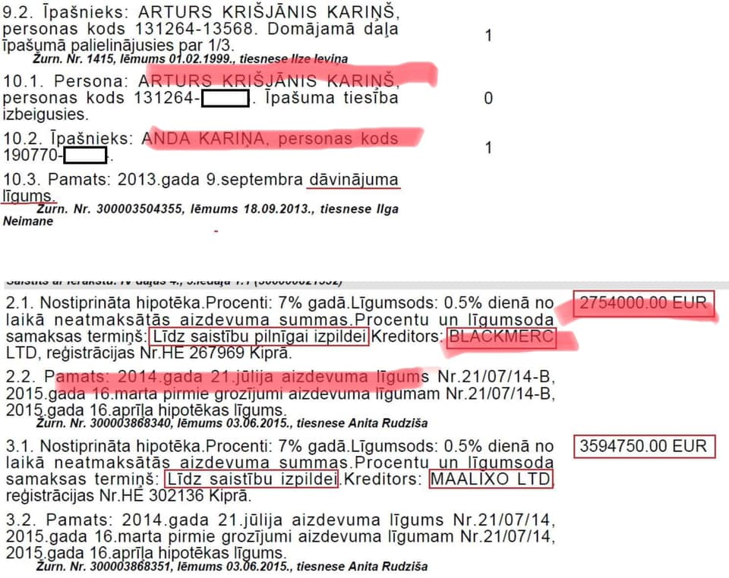
Six mln euros from Putin associate Vladimir Silkin!

Slide 6
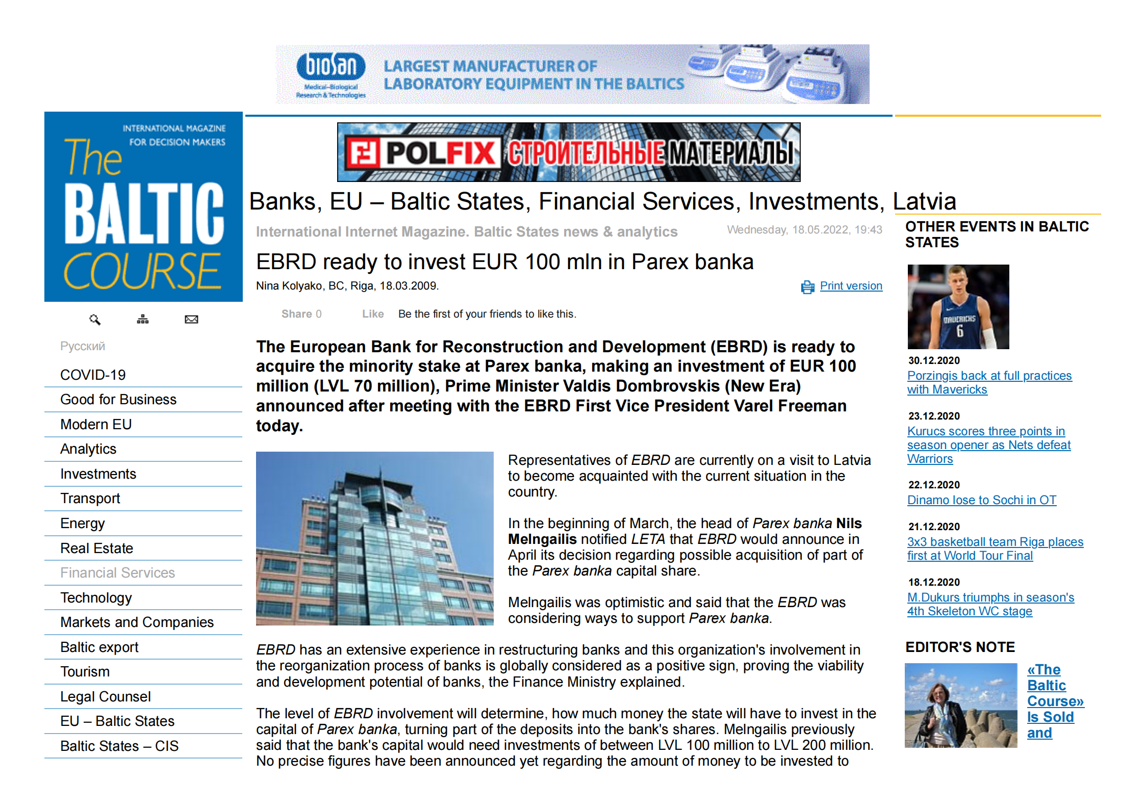
The EBRD announced an investment, but it was fake! Latvian politician Valdis Dombrovskis signed this, and now he is responsible for AML in Europe.

Slide 7
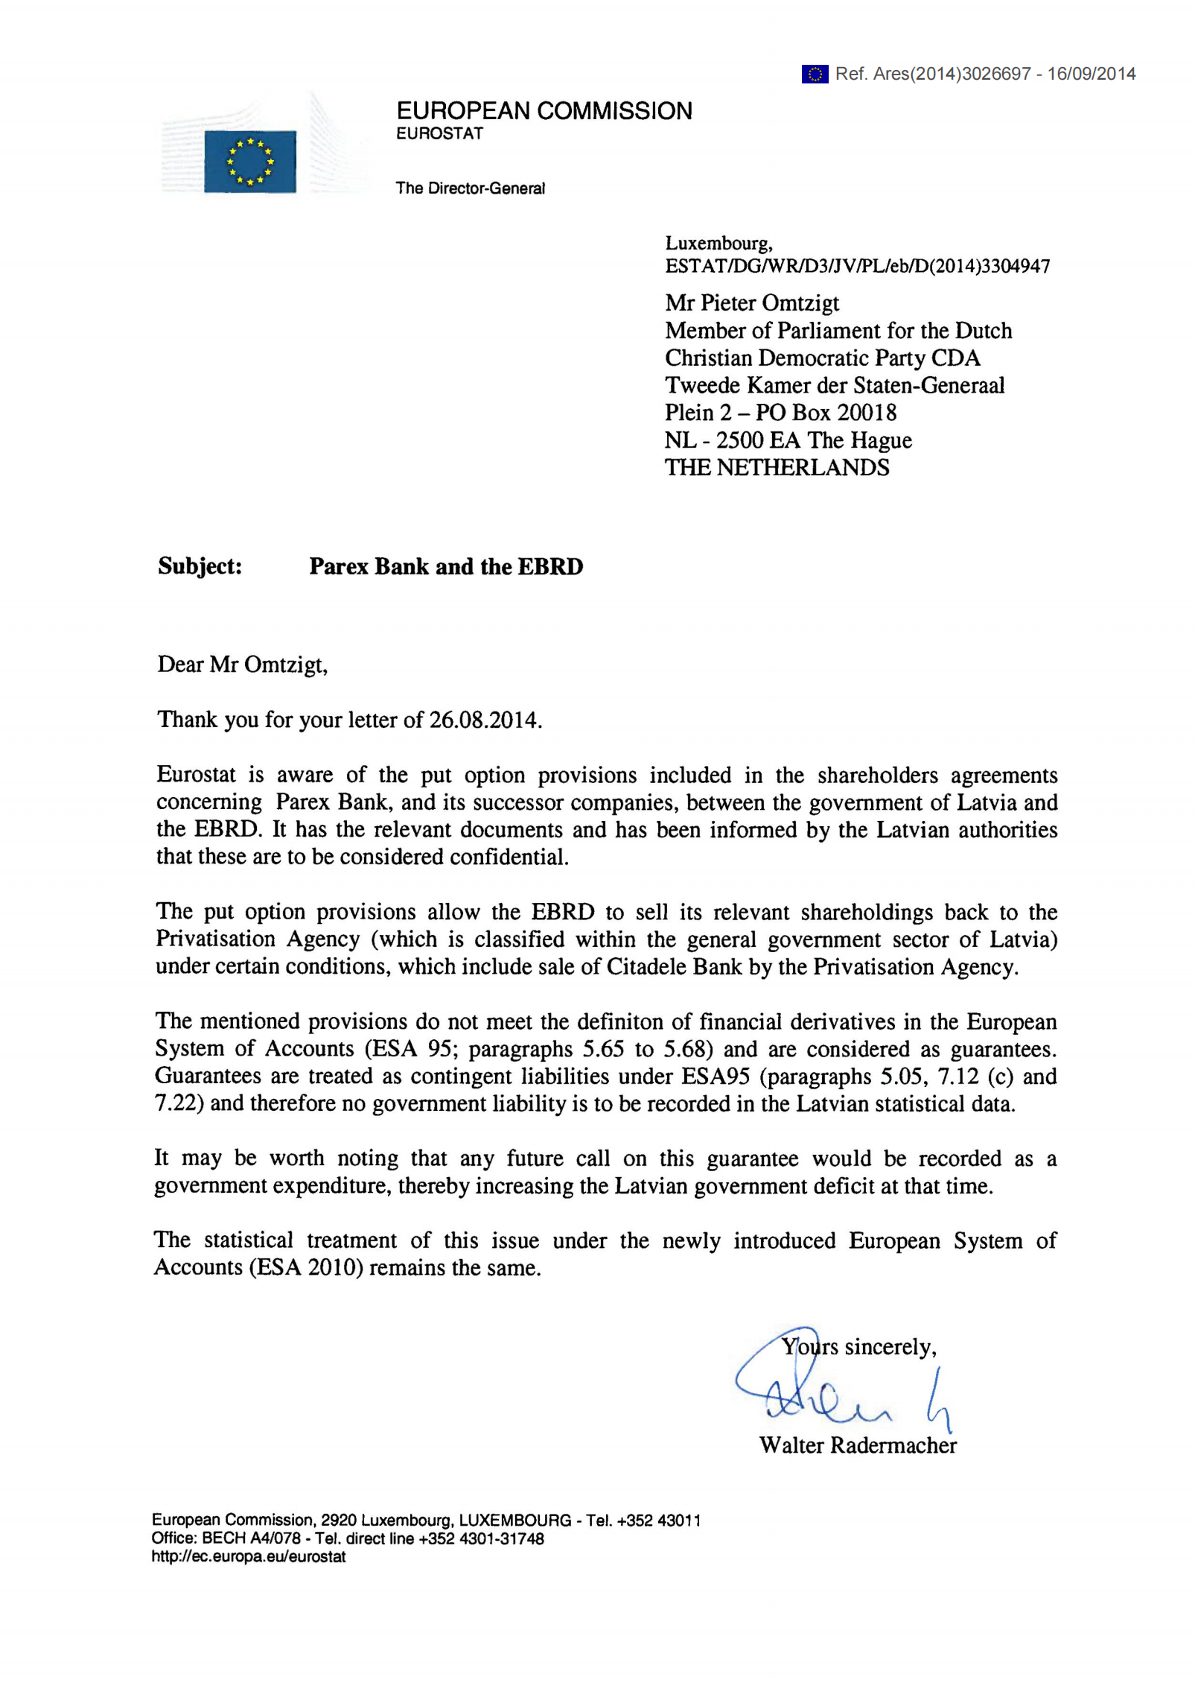
Eurostat: Latvia’s national debt is confidential

Slide 8
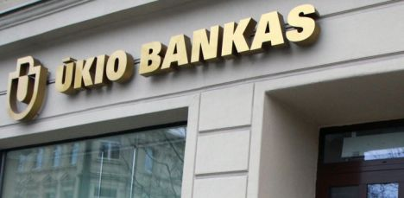
Ukio Bank and Sergey Roldugin

Slide 9
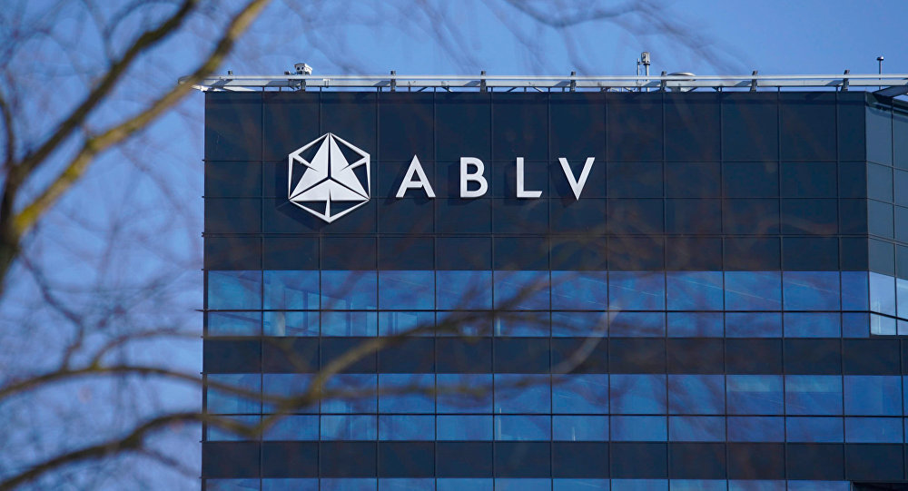
ABLV Bank - looting Moldova and Ukraine

Slide 10
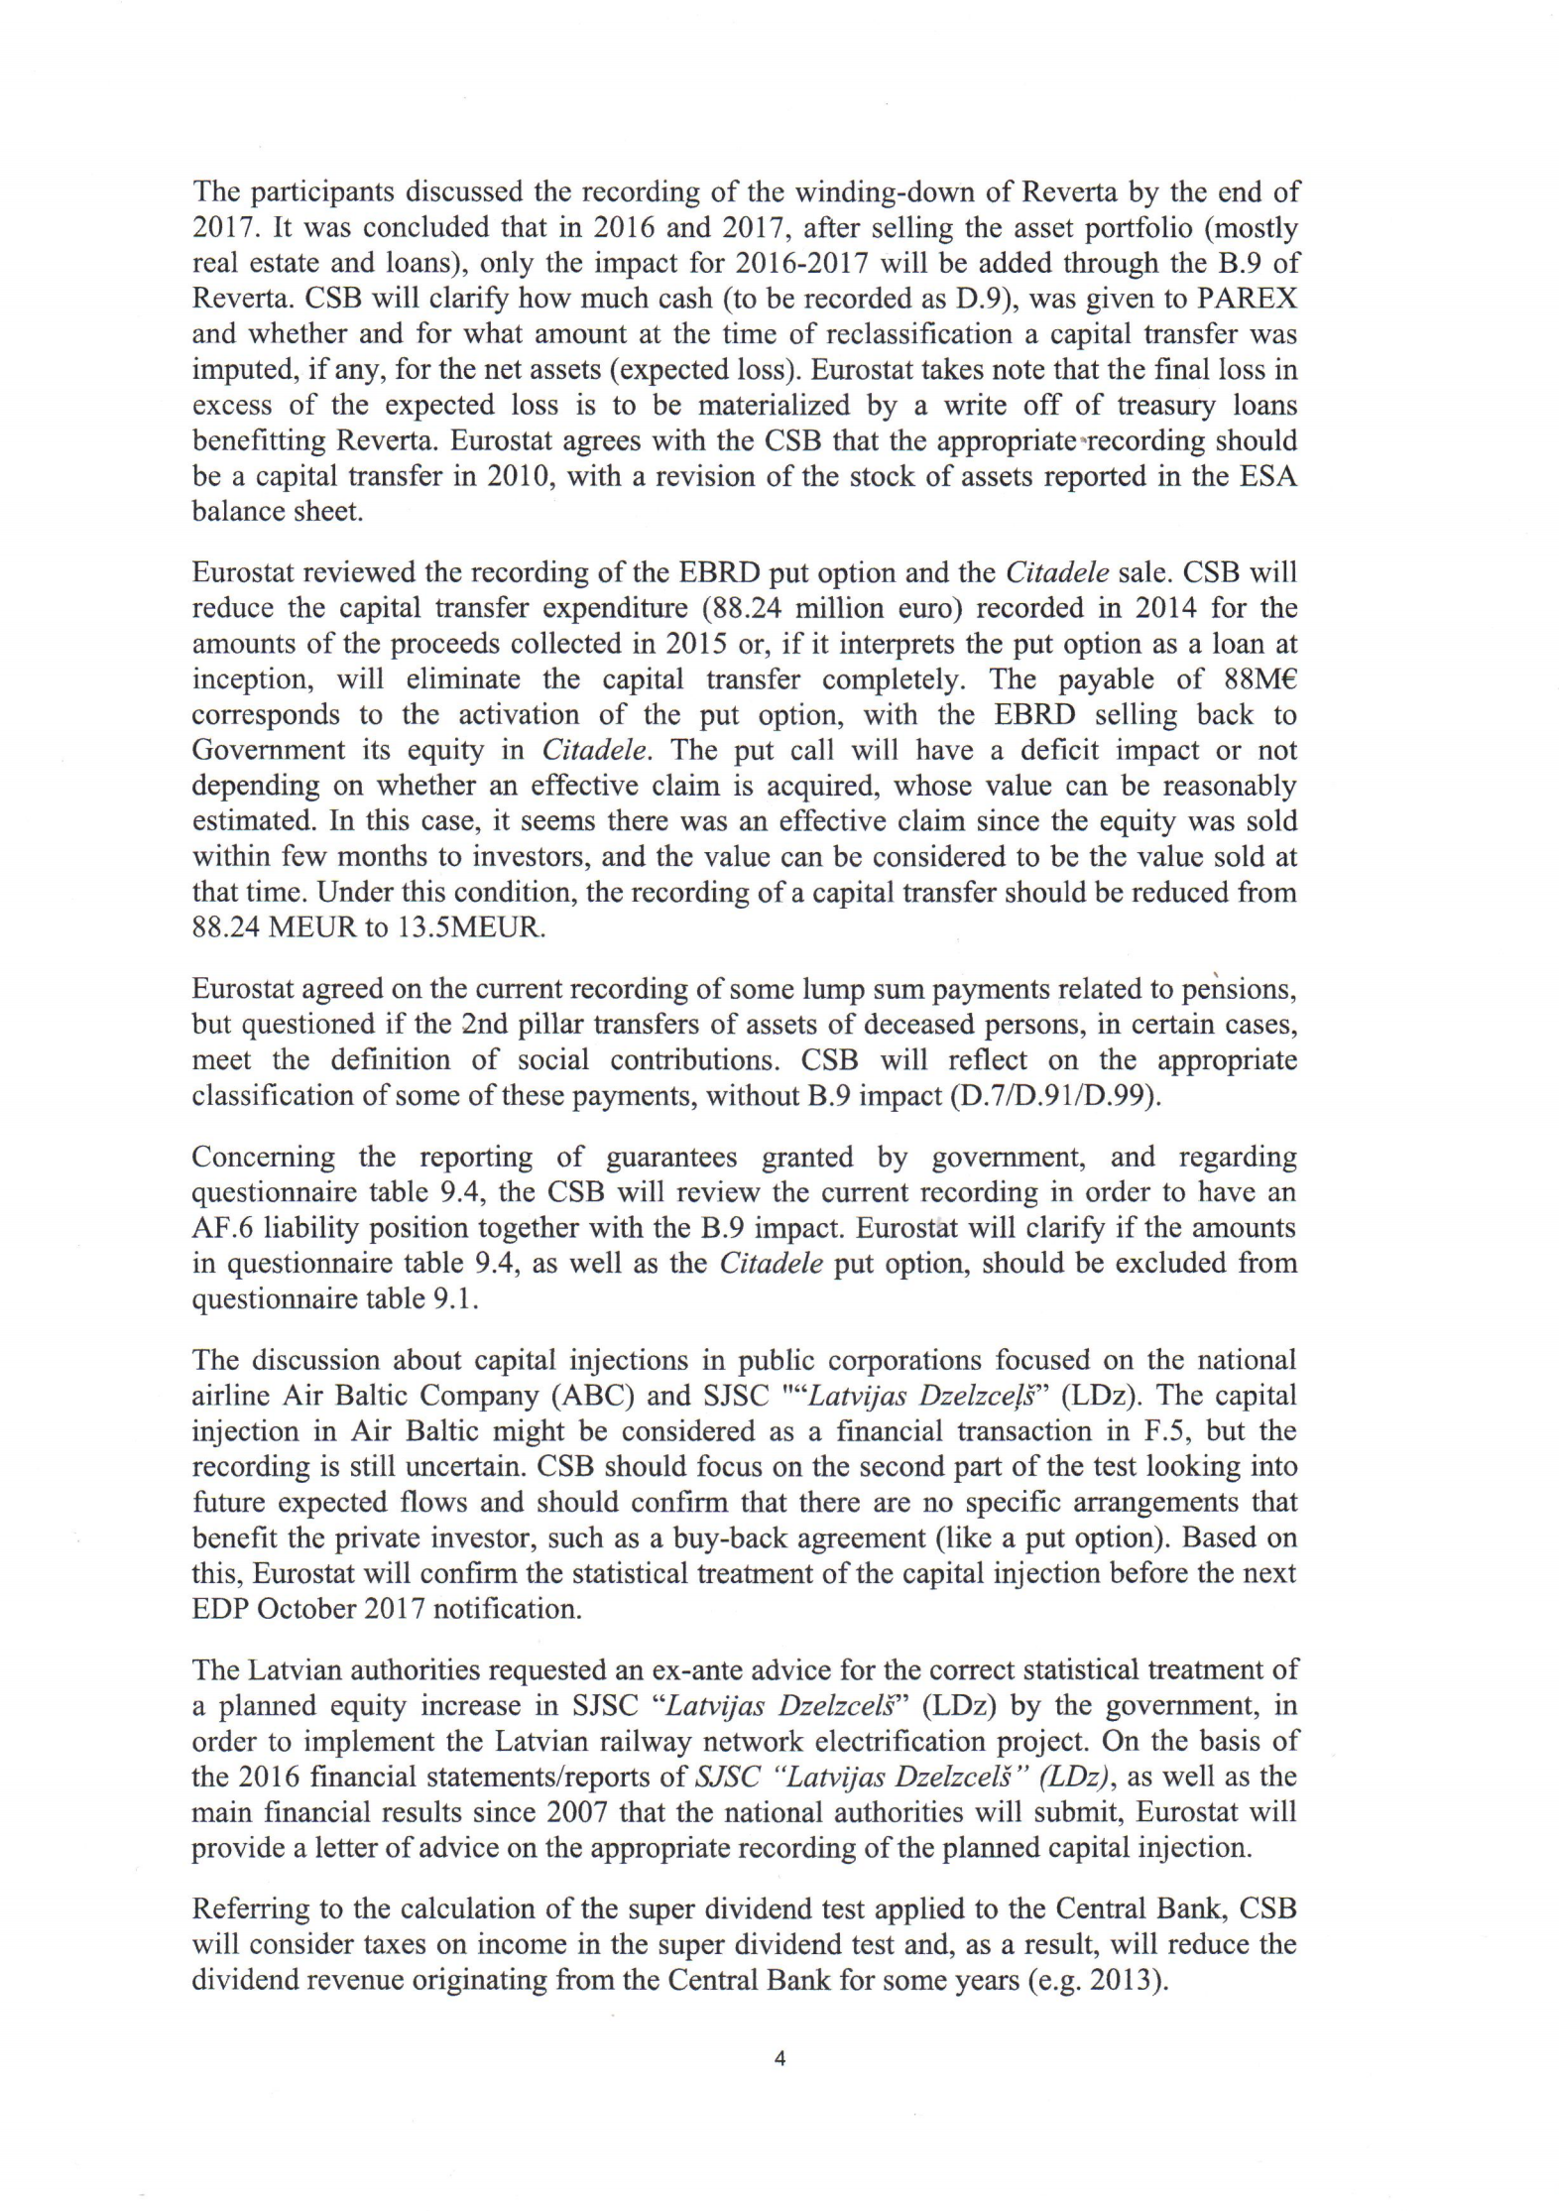
EBRD-Citadele investment again fake. Eurostat, EY, and ECB all know!

Slide 11
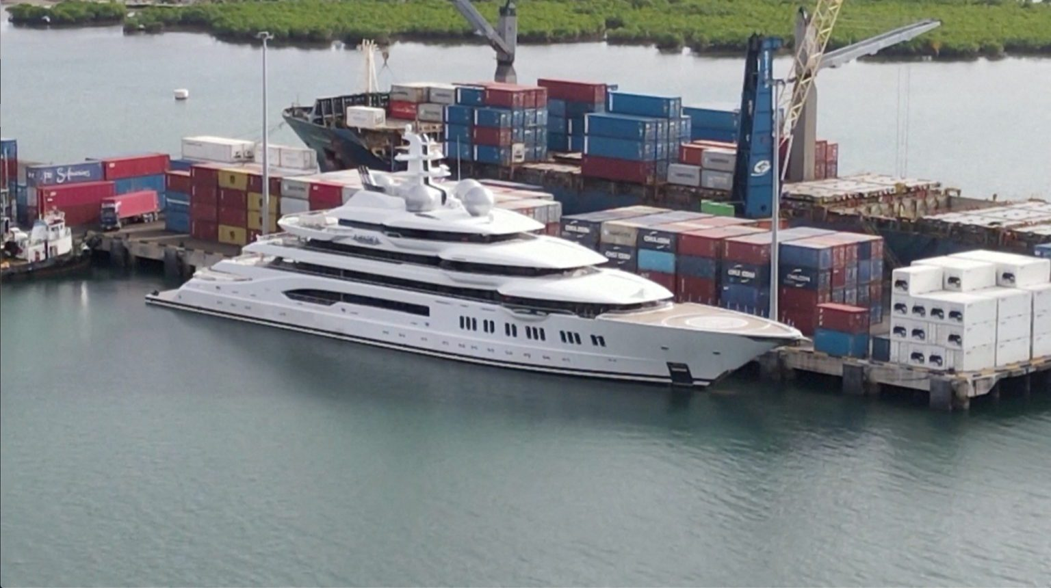

Kerimov and Putin use Khudainatov as fronts, this is where your tax money is going:

Slide 12
Let’s support integrity in Europe and defeat Putin!
@kgbbanker on Twitter
@lawlesslatvia on Twitter
www.kgbbanker.com
www.lawlesslatvia.com
LatviavEBRD on Youtube
Also, documentaries ‘Jumts 1’ by Ansis Pupols with ‘Jumts 2’ coming soon (‘The Roof’)

